Slide 1
Understanding the Function of Behavior:
Targeting the Big Three: A-B-C

Slide 2
Take A MOMENT
Reflect upon what we do and why we do it when interacting with others?
Reflect upon what we do and why we do it as professionals?

Slide 3
It’s all fun and games…..until someone finds out about the function of your behavior….

Slide 4
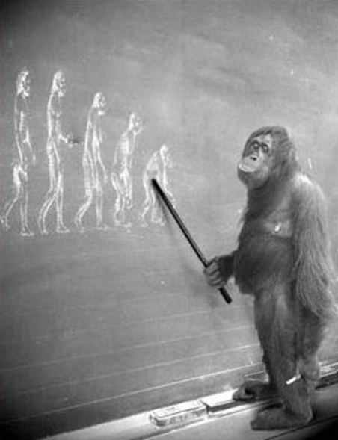
Behavior is:
Any action that:
Can be seen or heard
Is observable
Is measurable

Slide 5
All behavior serves a Purpose:
Behavior serves one of four functions (purposes):
To seek attention
To gain access to tangible items or participate in an engaging activity
To escape or avoid an activity, situation or person
For self- stimulation/sensory purposes

Slide 6
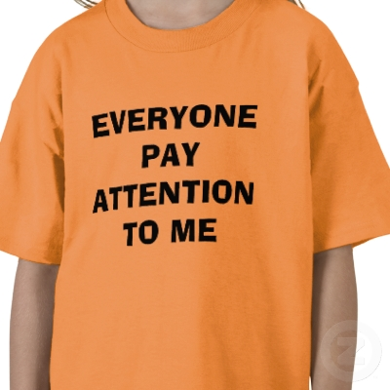
All behavior serves a Purpose:
To seek attention

Slide 7
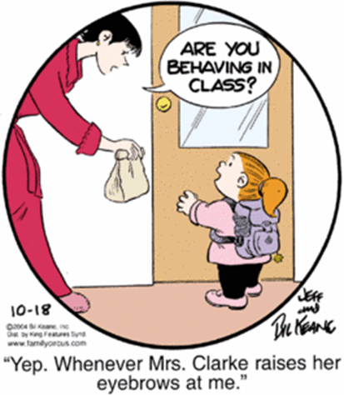
All behavior serves a Purpose:
To gain access to tangible items or participate in an engaging activity

Slide 8
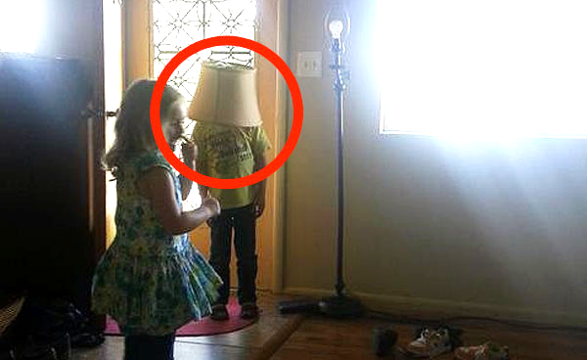
All behavior serves a Purpose:
To escape or avoid an activity, situation or person

Slide 9
All behavior serves a Purpose:
For self- stimulation/sensory purposes

Slide 10
Behavior is Communication
The way we communicate with others and with ourselves
ultimately determine the quality of our lives.
Anthony Robbins

Slide 11
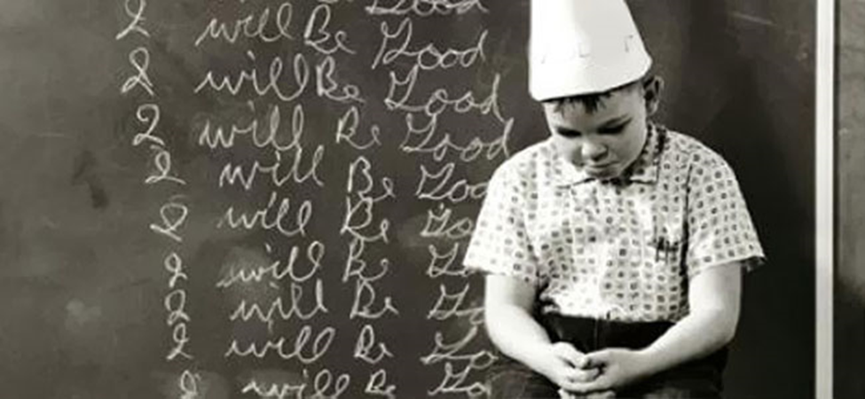
Functions of Behavior
Functions of Behavior: Consequence and Punishment
A video by Marcus Perez, MA Founder and Executive Director of Elite Behavior Analysis, LLC

Slide 12
Take a Moment
I possess tremendous power to make
_______________ life miserable or joyous.
I can be a
tool of torture
Or an
Instrument of
Inspiration.
I can humiliate or humor, hurt or heal.

Slide 13
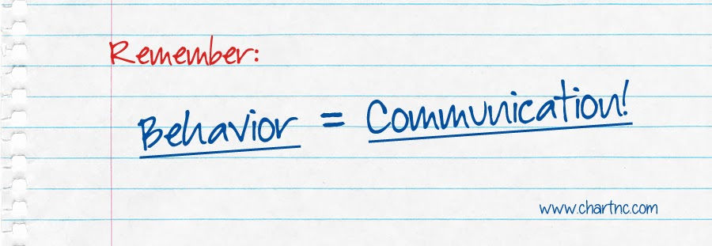
Functional Behavioral Assessments:
A systematic process used to determine the function a student’s behavior is serving and involves examining the relationship between a student’s behavior and the environment in which it occurs.

Slide 14
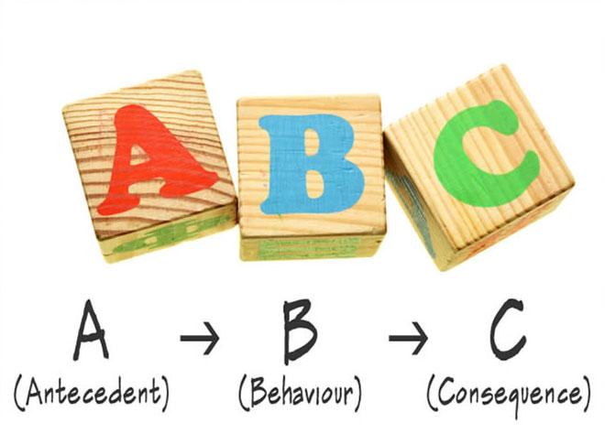
A-B-C Model
Changing behavior through good design,
one step at a time.

Slide 15
A= antecedent (Triggers)
What happens before the behavior?
Possible Triggers:
Told to begin / end a task
Told “No”
No preferred staff giving direction
Transition between teacher lead tasks to independent tasks
Teacher attention to a peer
Peer comment
Rushed routine
Environmental conditions

Slide 16
A= antecedent (Triggers)
Setting
Event
Person

Slide 17
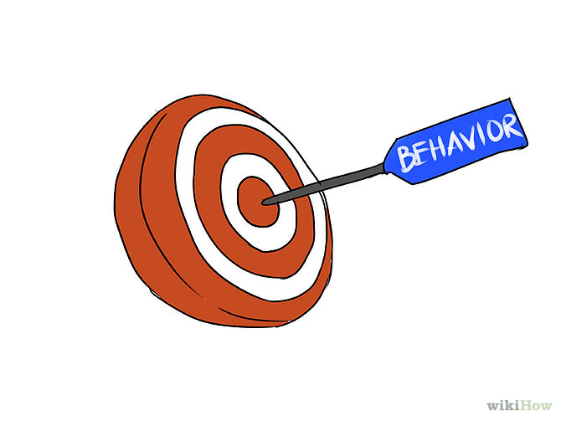
B= Behavior (Target Behavior)
What is happening now?
Swearing
Yelling
Crying
Smirking
Pokes
Hits
Bites
Making fun of a peer
Out of assigned area

Slide 18
B= Behavior (Target Behavior)
Be Specific
Be Detailed
Be Objective

Slide 19
C= Consequence (Response)
What happens after behavior occurs?
Problem behavior | Response | Will it happen again?
Making fun of peer | Peer laughter | yes
Making fun of peer | Loosing recess | no

Slide 20
FUNCTION BASED INTERVENTION STRATEGY
INTEREVENTION IS FOCUSED ON PREVENTION
Positive Behavioral Support

Slide 21
www.cea.fedcap.org

